Slide 1

Front End Engineering-II
Project Report Semester-IV (Batch-2022)
Carstore Website (Template 27)
Supervised By:
Raveesh Samkaria
Submitted By:
Sambhav Yadav 2210990774
G-12
Department of Computer Science and Engineering Chitkara University Institute of Engineering & Technology,
Chitkara University, Punjab

Slide 2
ABSTRACT
The carstore website emerges as a dynamic platform tailored to the needs of passionate car enthusiasts and discerning vehicle owners alike. In today's automotive landscape, characterized by a fervent desire for personalized vehicle aesthetics and performance, there exists a burgeoning demand for high-quality car accessories that transcend mere embellishment. Recognizing this evolving market ethos, our website endeavors to carve a niche by providing a meticulously curated selection of automotive enhancements. By offering a diverse array of accessories ranging from interior embellishments to functional upgrades, our platform seeks to elevate the driving experience to new heights. With a steadfast commitment to quality, innovation, and customer satisfaction, we aspire to cultivate a vibrant community of automotive aficionados united by their shared passion for automotive customization and refinement. Through an intuitive and user-friendly interface, we aim to empower our customers to navigate seamlessly through our catalog, discover their desired accessories, and embark on a journey of automotive self-expression and enhancement. Welcome to our world, where every accessory embodies the spirit of automotive excellence and serves as a testament to your unique automotive identity.

Slide 3
Introduction
Background:
Behind the scenes, our team of dedicated professionals works tirelessly to ensure that every element of our website, from the HTML and CSS coding to the user interface design, is meticulously crafted to deliver an exceptional user experience. We draw inspiration from the latest trends in technology and design to ensure that our website remains at the forefront of the digital automotive landscape.
Objectives:
Ensure that our website adapts seamlessly to different screen sizes and devices, providing an optimal viewing experience for users.
Approach: Utilize a combination of HTML, CSS, and JavaScript to implement responsive design principles. Employ CSS media queries to adjust layout, font sizes, and image sizes based on the device's screen width.
Outcome: Users can access our website from desktops, laptops, tablets, and smartphones, experiencing consistent usability and functionality across all devices.
Significance:
The importance of this template lies in its ability to meet intuitive platforms that empower you to manage and update your website with ease.
Welcome to Carstore, where our passion for automobiles drives us to create immersive and exceptional online experiences tailored to car enthusiasts and owners. At Carstore, we are dedicated to providing a platform that seamlessly integrates cutting-edge technology, user-centric design, and flawless functionality to enhance your car customization journey. Our focus on HTML and CSS craftsmanship, with a touch of JavaScript, ensures that every aspect of our website is meticulously designed to offer an intuitive and engaging user experience. Whether you're browsing from your desktop or mobile device, our website templates are optimized to deliver a seamless viewing experience, allowing you to explore our diverse range of high-quality car accessories with ease. Join us as we embark on a journey to elevate your car experience and empower you in the digital automotive landscape. Welcome to Carstore, where innovation meets automotive passion.

Slide 4
Problem Definition:
The problem CarStore Website aims to address is the inconvenience of accessing high-quality car accessories for enthusiasts and owners. Traditional methods of purchasing accessories, like visiting physical stores or navigating multiple online platforms, prove time-consuming and inefficient. Additionally, concerns about product authenticity and quality further complicate the buying process. CarStore Website seeks to streamline this experience by offering a user-friendly online platform where customers can easily browse and purchase a diverse range of accessories. By prioritizing transparency, reliability, and a seamless user experience, CarStore Website aims to alleviate the challenges faced by car enthusiasts in finding the perfect accessories for their vehicles.
Requirements:
Implement responsive design principles using HTML, CSS, and JavaScript to ensure the website adapts seamlessly to various screen sizes and devices.
Utilize media queries in CSS to adjust layout, font sizes, and content placement based on screen width, prioritizing mobile responsiveness.
Structure the website content with semantic HTML elements for logical organization and improved accessibility.
Style elements consistently and aesthetically using CSS for fonts, colors, spacing, and layout across the website.
Enhance user interactivity and functionality through JavaScript by implementing dynamic elements such as dropdown menus, image carousels, and interactive forms.
Use JavaScript for client-side form validation to ensure data accuracy and provide real-time feedback on user input.
Optimize HTML, CSS, and JavaScript code for performance, efficiency, and cross-browser compatibility to maintain a smooth user experience.

Slide 5
Proposed Design:
The proposed design for the CarStore website entails the development of a responsive e-commerce platform using HTML, CSS, and a touch of JavaScript, catering to both desktop and mobile users seamlessly.
Understanding the user requirements is paramount to crafting an intuitive and engaging online shopping experience for car enthusiasts. Responsive design techniques will be employed using CSS media queries to ensure that the website layout and styles adjust appropriately for different screen sizes and devices.
The HTML structure will prioritize semantic elements for clarity and accessibility, while CSS will be utilized for styling to maintain code cleanliness and ease of maintenance.
Defining breakpoints within the CSS media queries will enable the website to adapt its layout and optimize content presentation across various screen sizes, ensuring consistency and usability.
Additionally, viewport units (vw, vh) will be implemented within media queries to create fluid and responsive designs that maintain aesthetics across different viewport sizes. This thoughtful approach aims to deliver a seamless browsing experience for users, whether they are accessing the website from their desktop or mobile device.

Slide 6
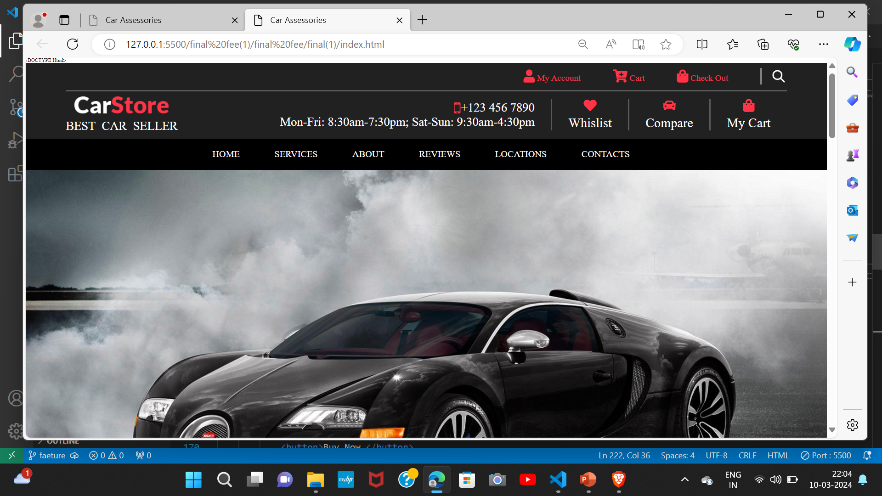
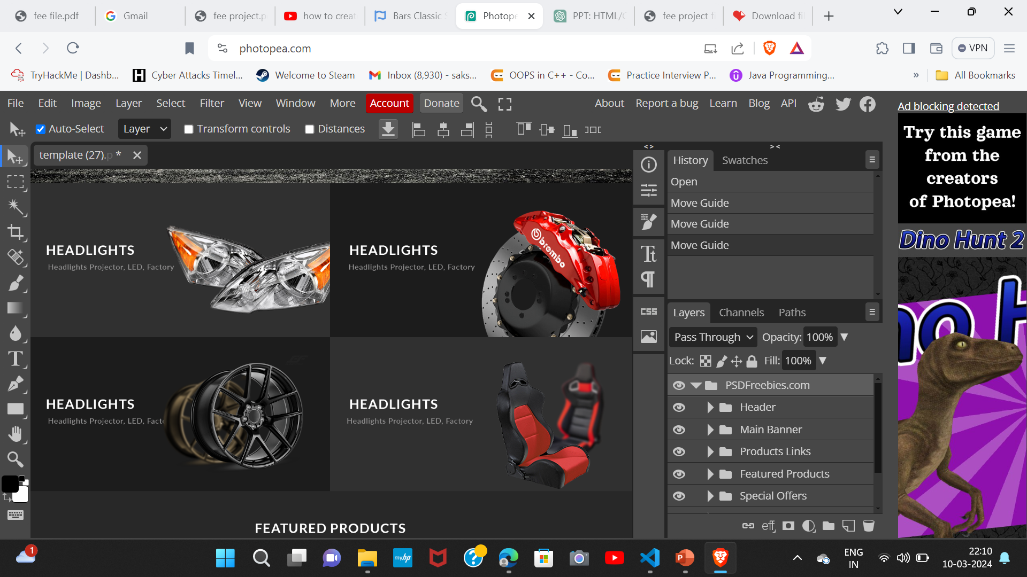
Results:
Snippets of the website attached below:
4.1 Desktop view:

Slide 7
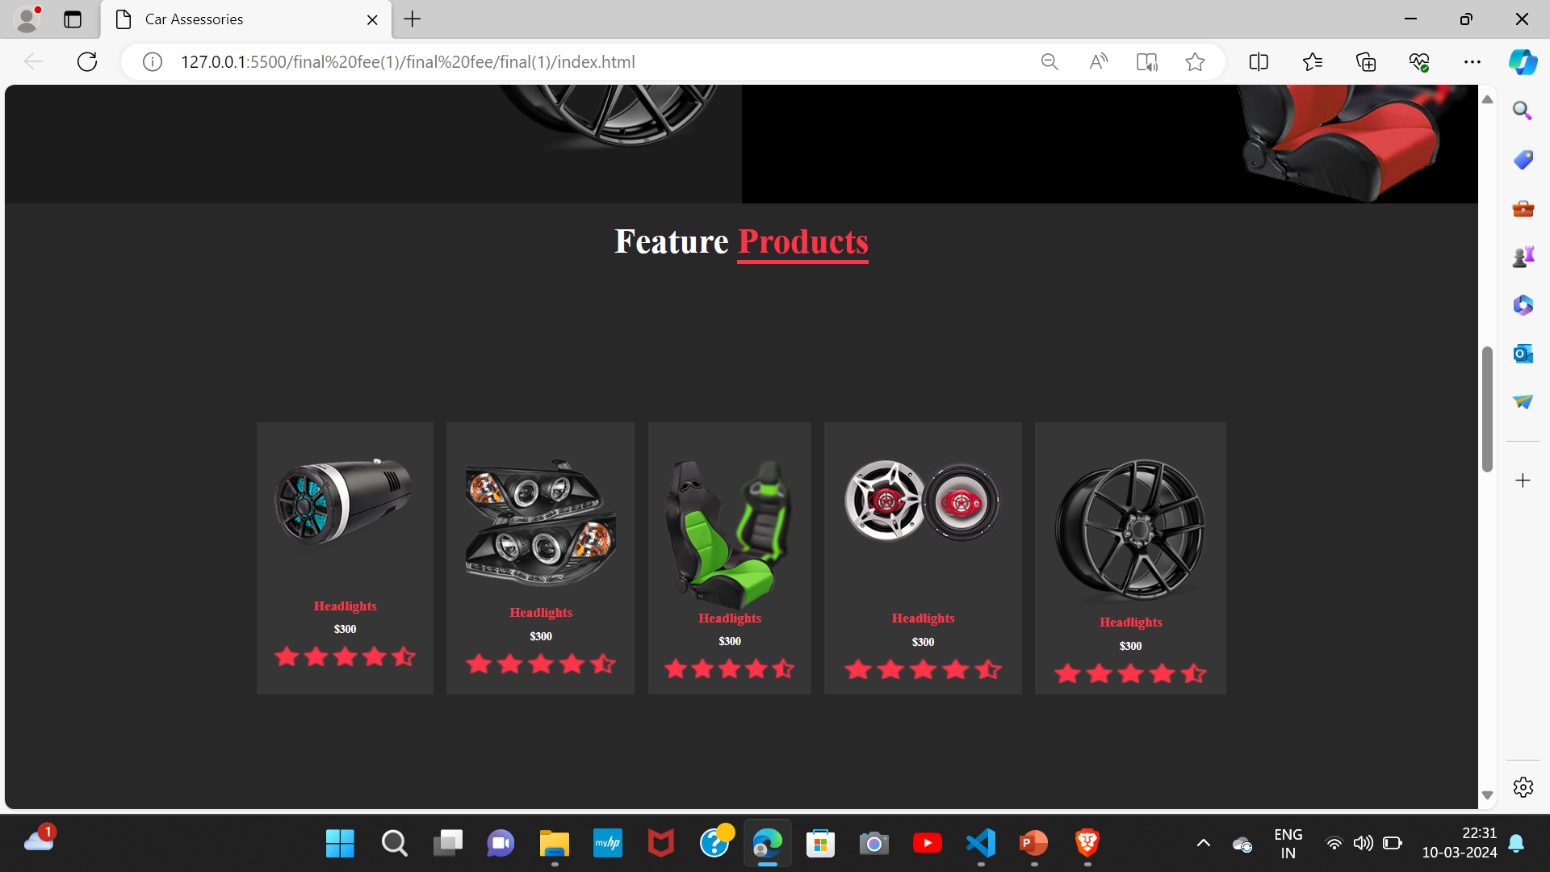
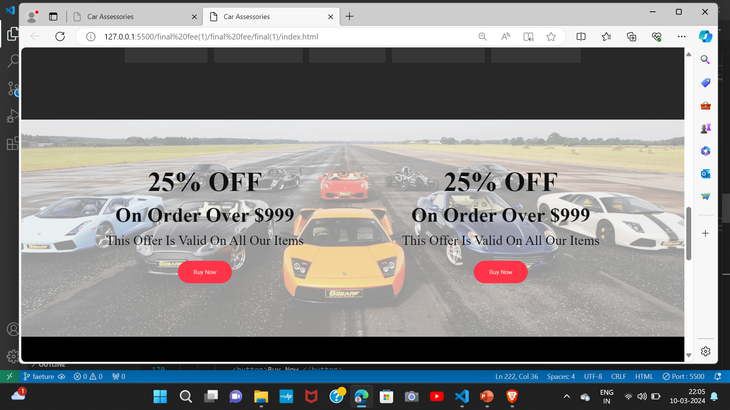

Slide 8
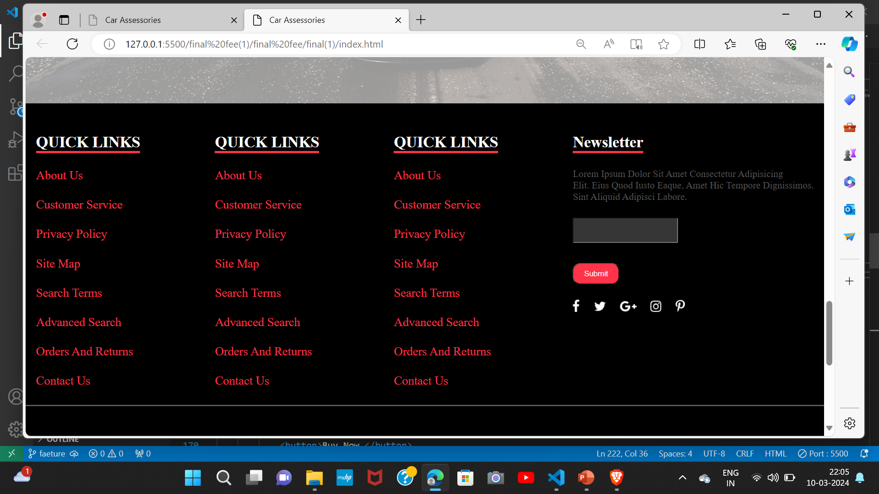
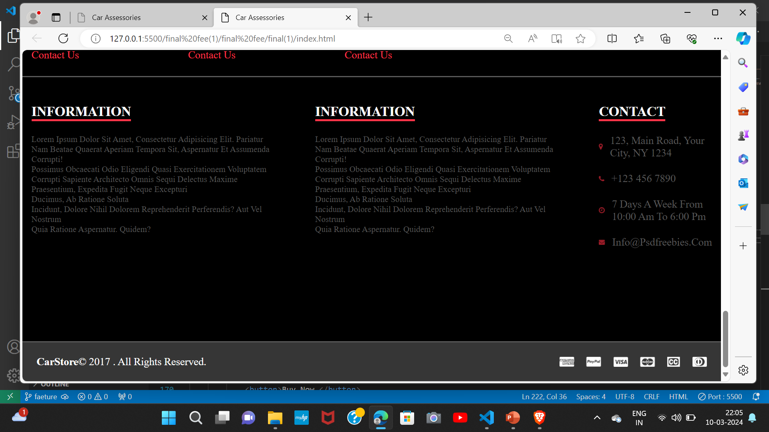

Slide 9
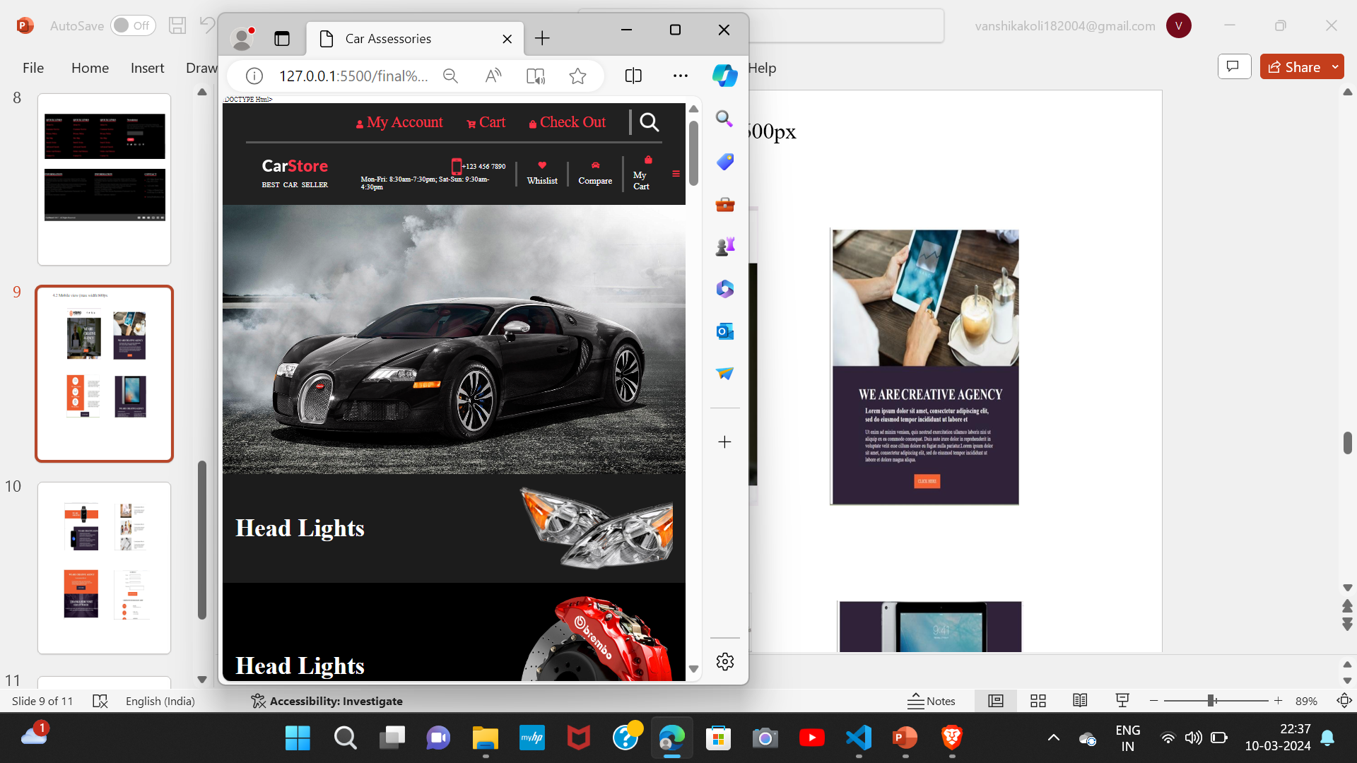
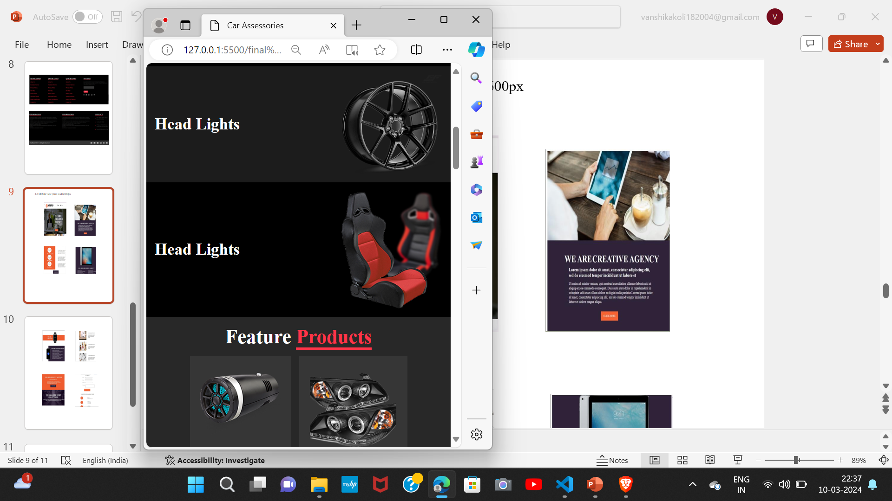
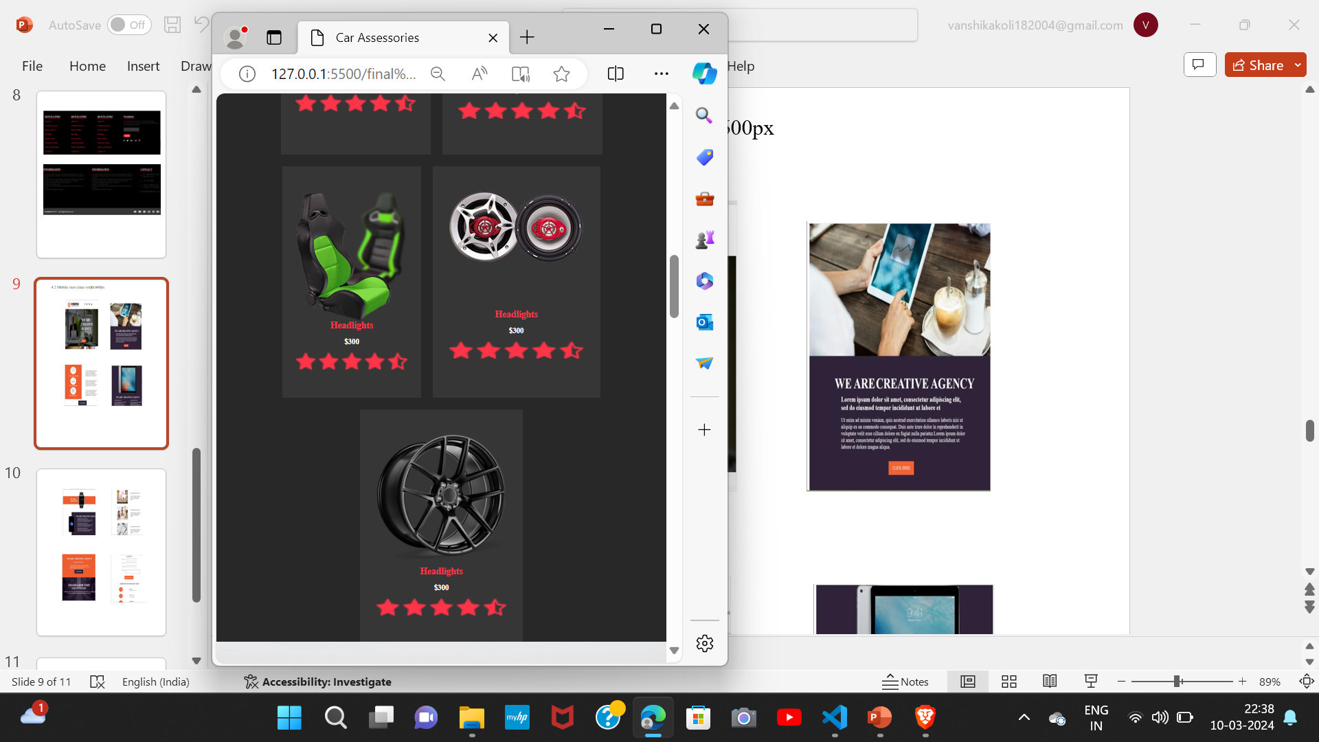
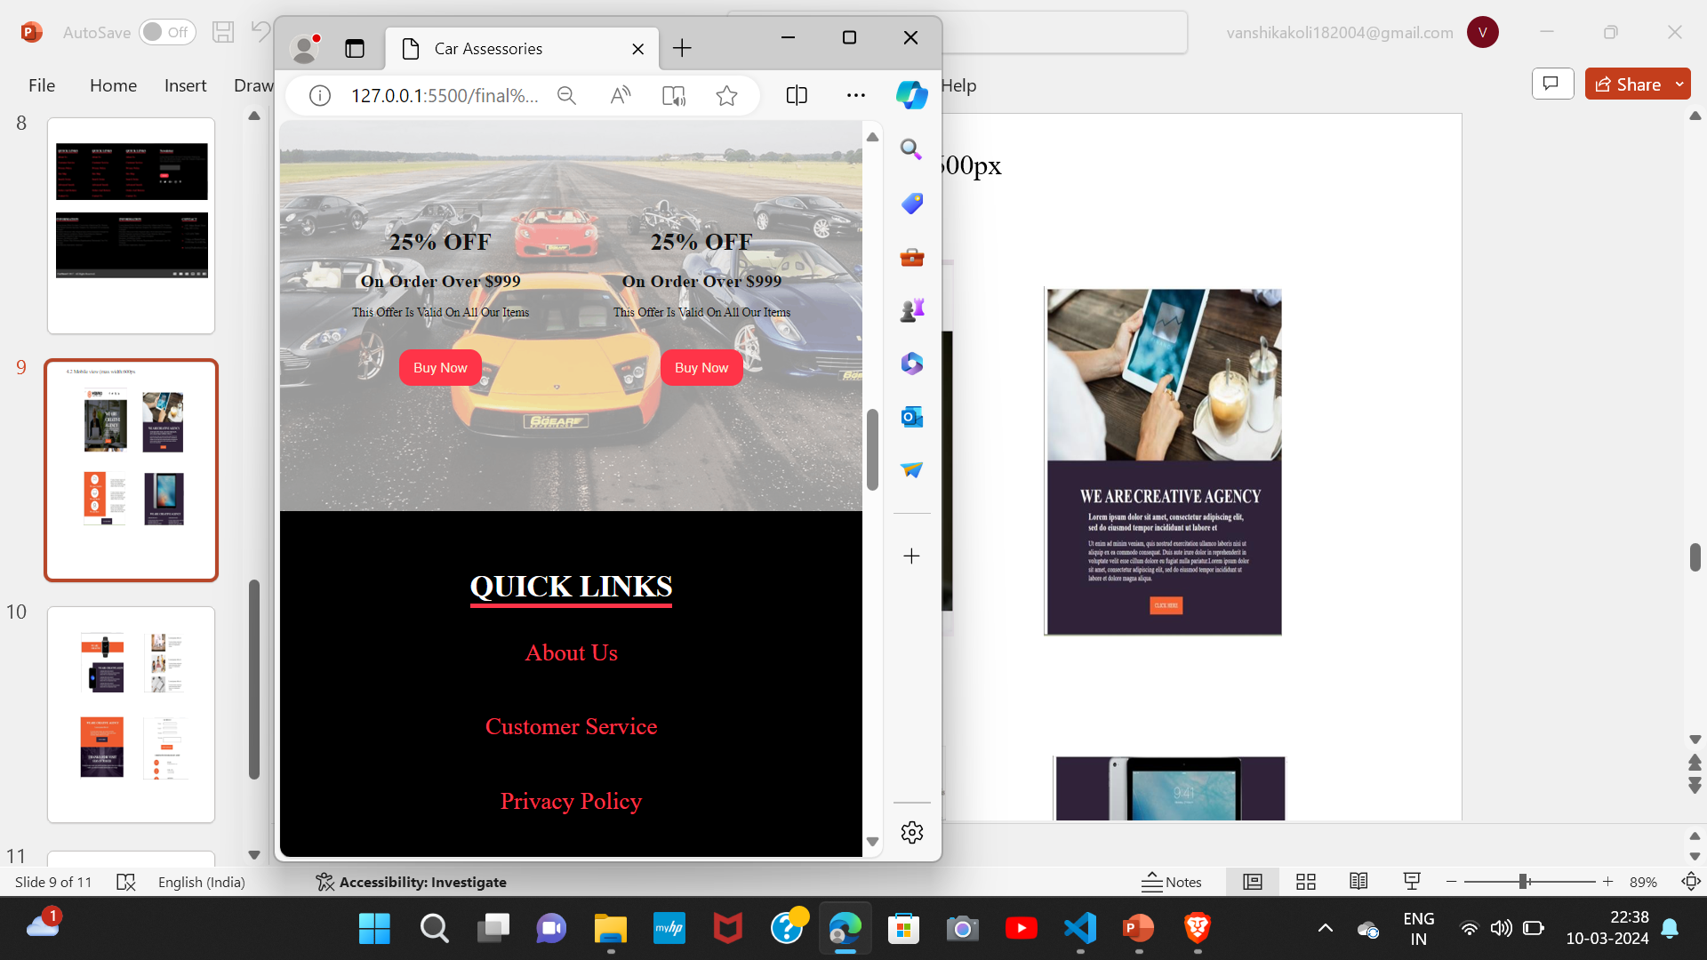
4.2 Mobile view (max width:600px)

Slide 10
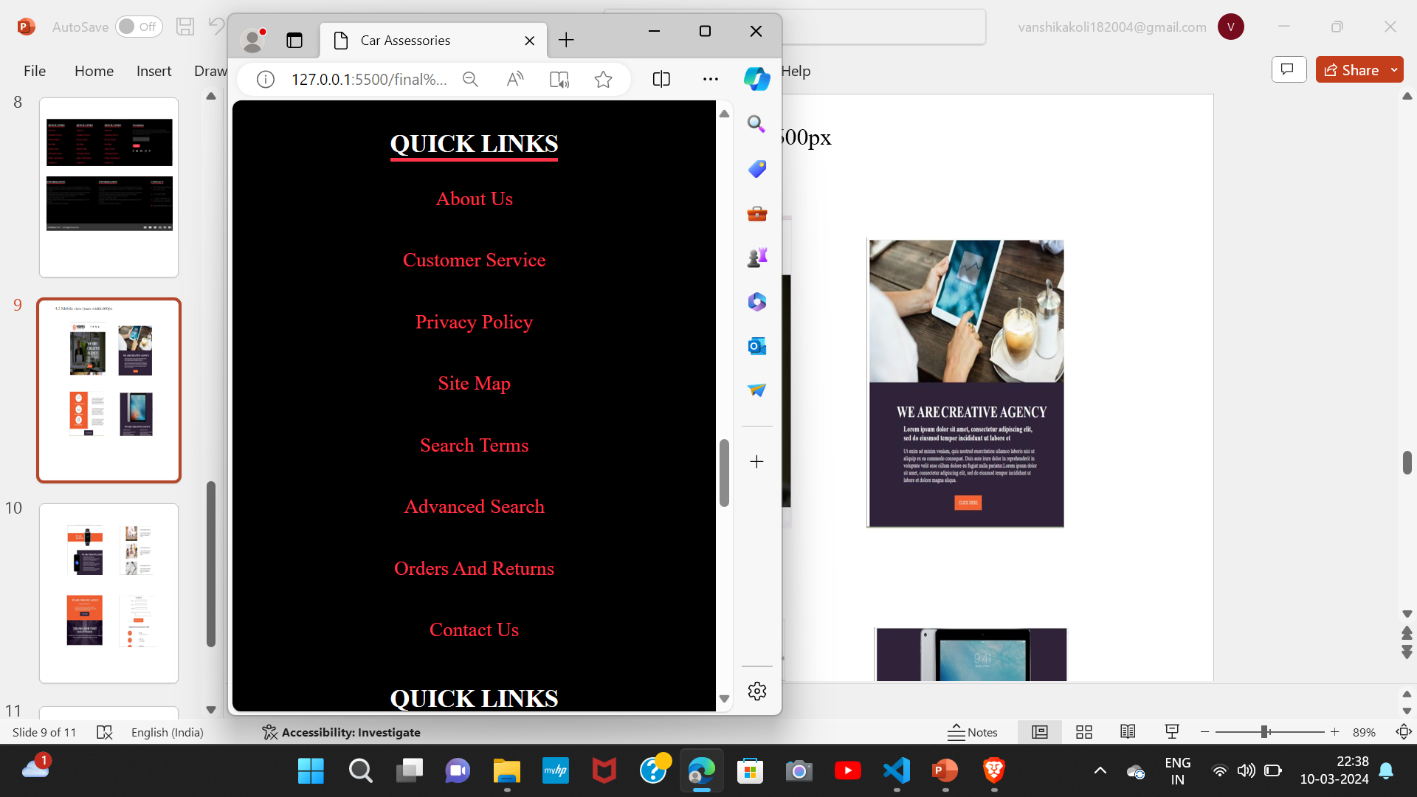
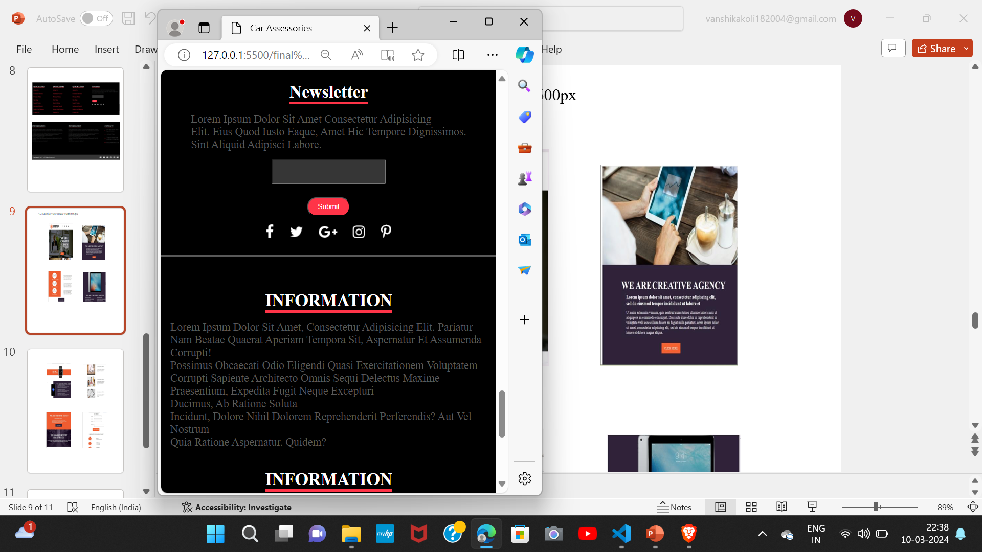
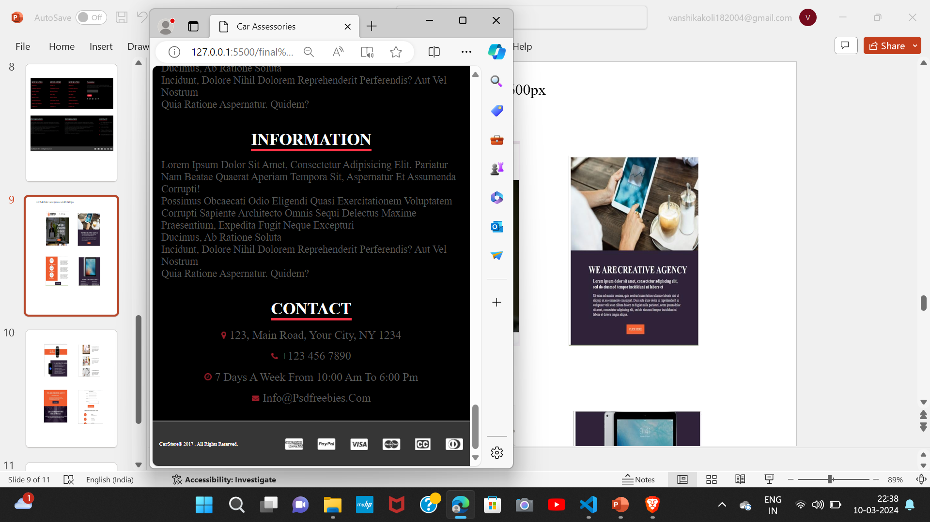

Slide 11
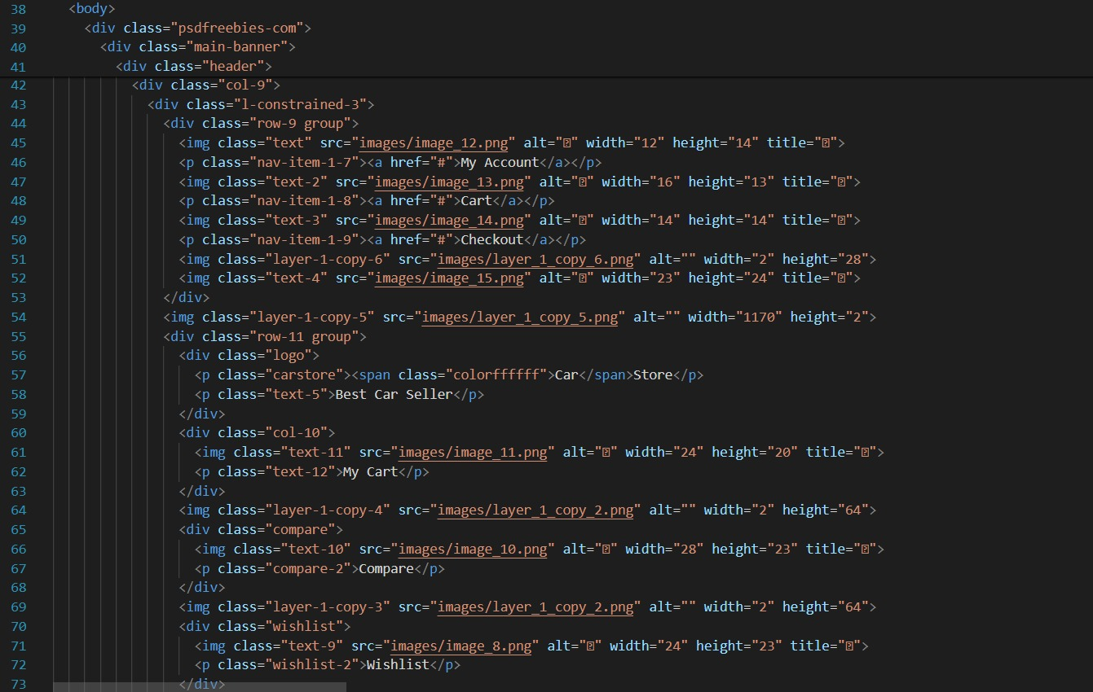

Slide 12
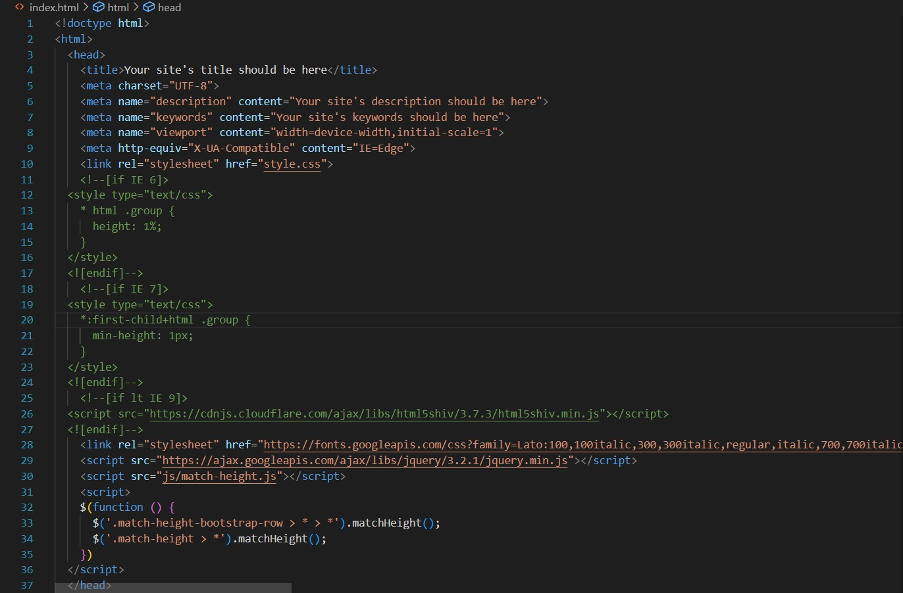
Code : Index,html

Slide 13
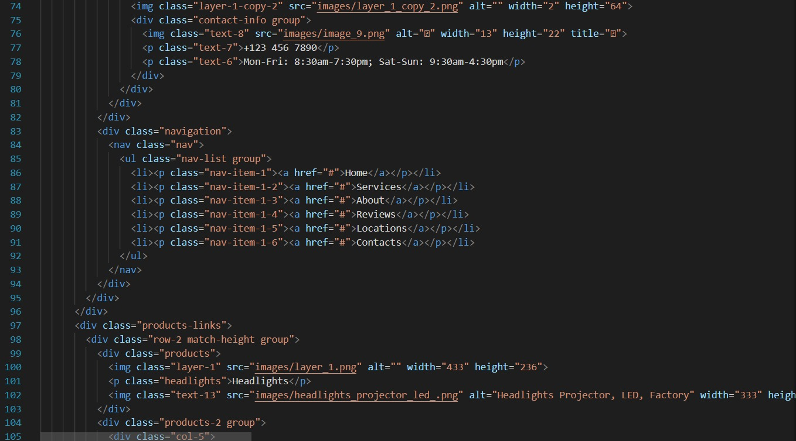
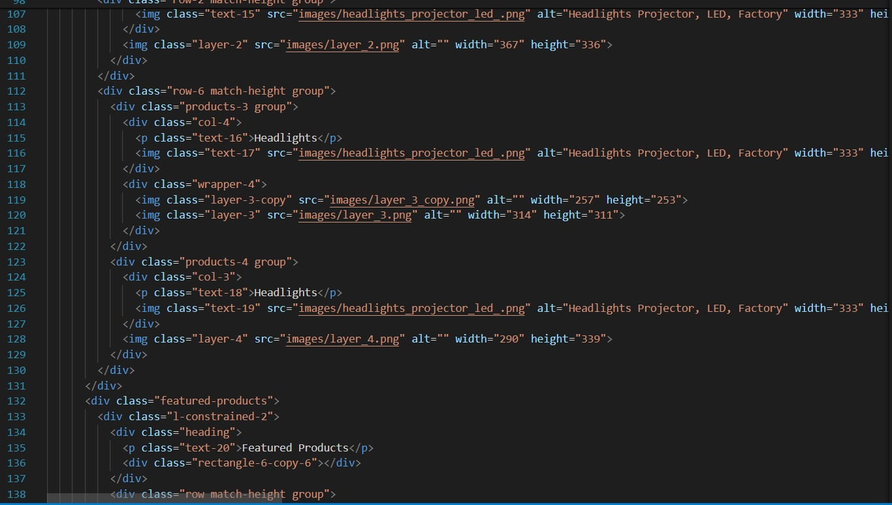

Slide 14
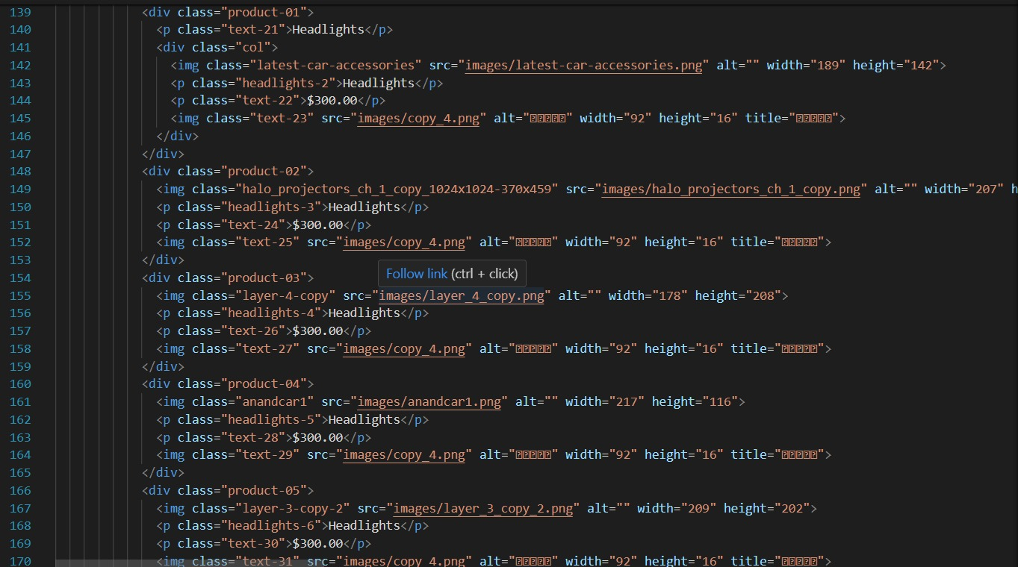
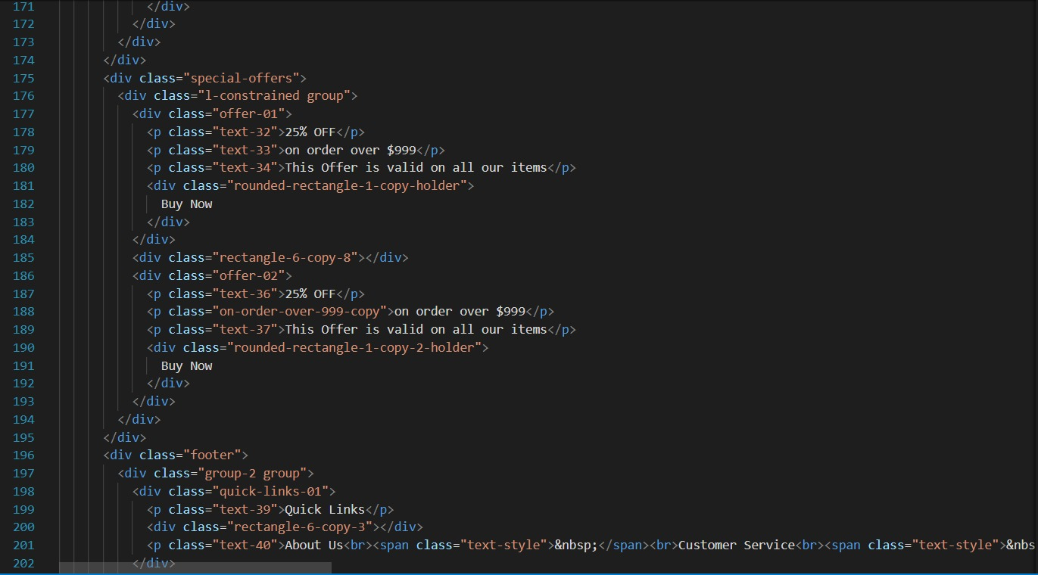

Slide 15
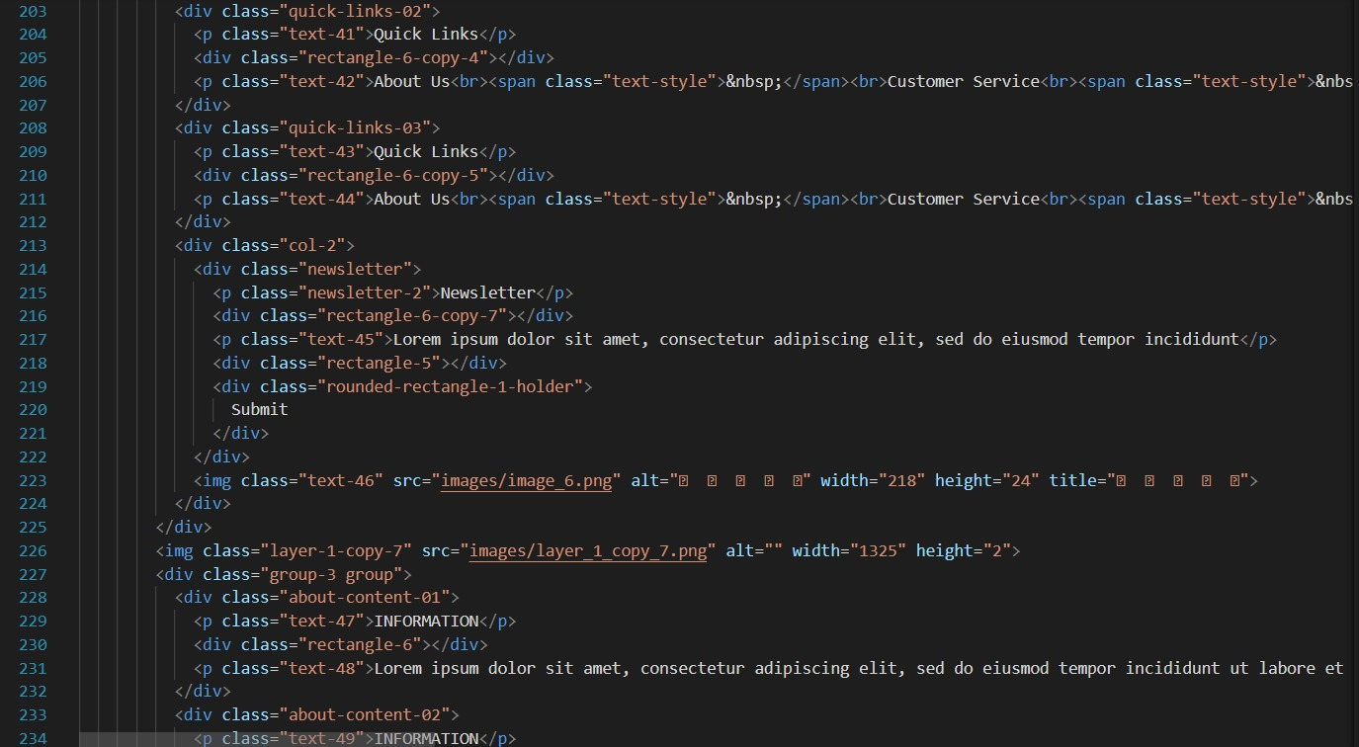

Slide 16
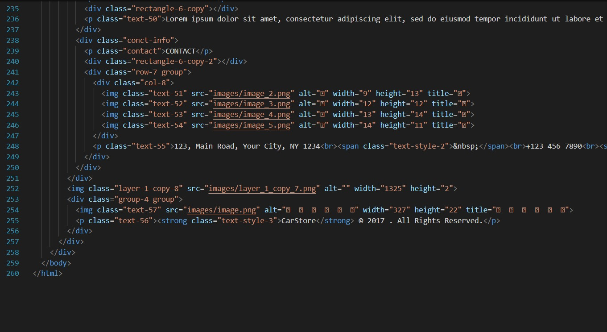

Slide 17
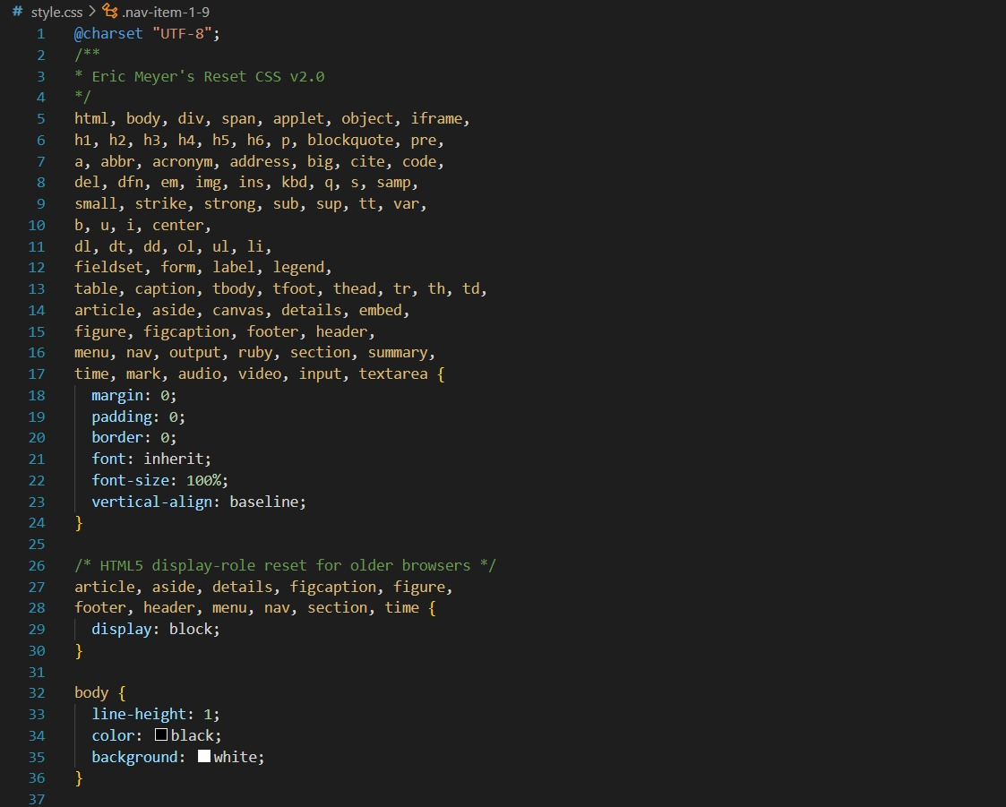
Index.css

Slide 18
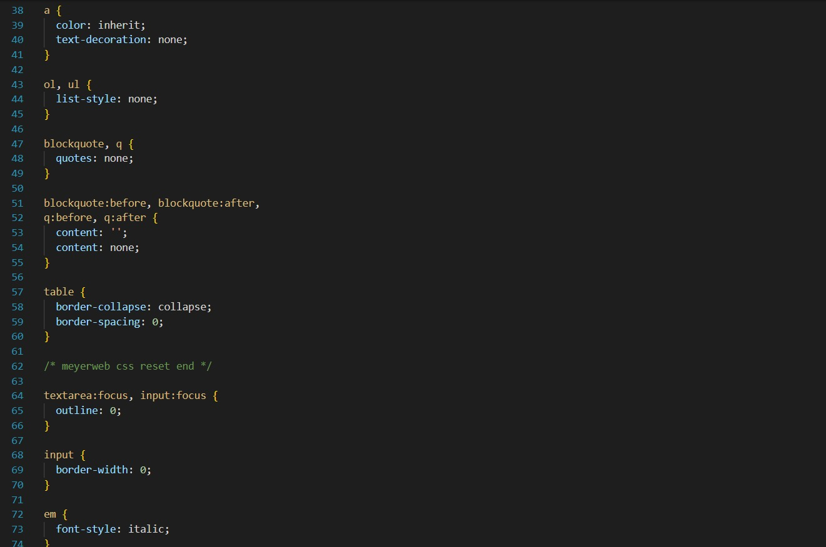
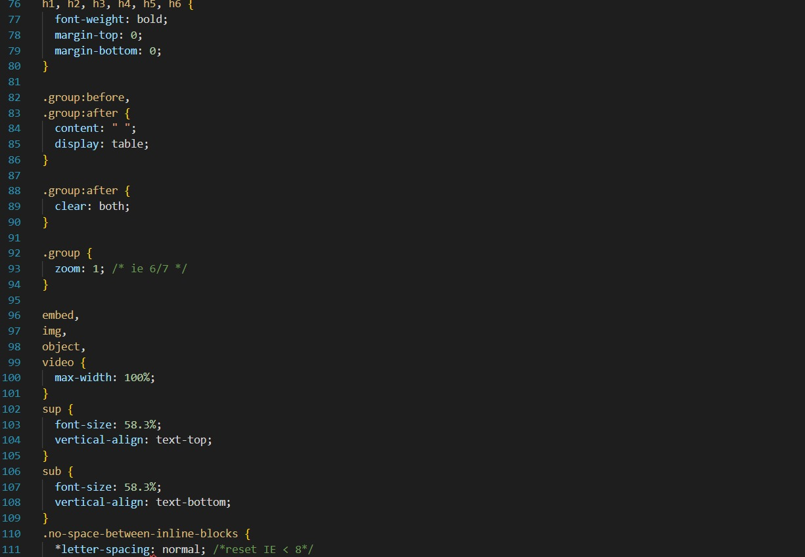

Slide 19
